Slide 1
CA2 DSAA Title: 2 Individual Features By: Loh Yip Kha (p2317454)

Slide 2
Features
Feature 1: Night Delivery
Scenario: Time of day will be at night where there is not much visibility, therefore path will be hidden and Drone must navigate through the “blind” maze to reach the end
Feature 2: Obstacle Avoidance
Scenario: While the drone is doing the delivery, there may be obstacles such as birds blocking the drones path. The drone needs to reach the end by avoiding the birds as much as possible, to deliver in the fastest time.

Slide 3
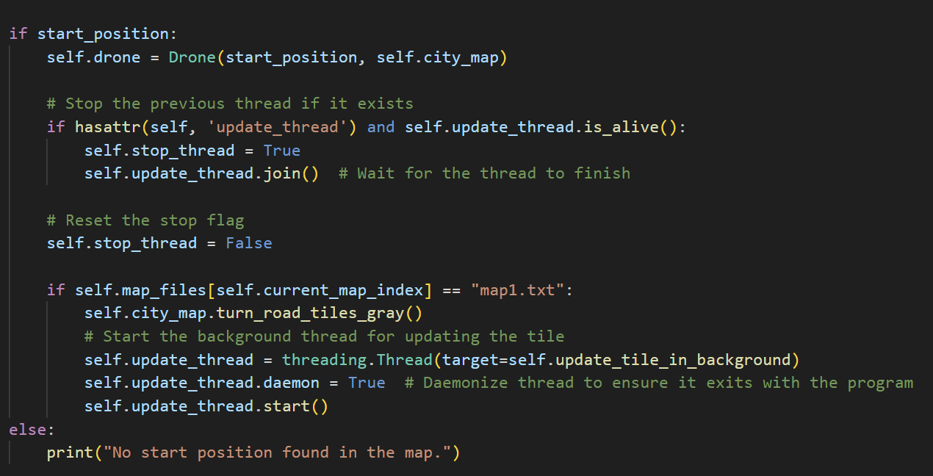
Code added for Feature 1 (Night Delivery)
Load_map function in player_mode.py has been modified (See Figure 1)
When loading the Night Delivery Map(map1.txt), all the tiles will be set to gray
Added a threading function to keep checking each tile at the position of the Drone.
If the Drone has uncovered the path, change the current tile color from gray to white
Figure 1

Slide 4
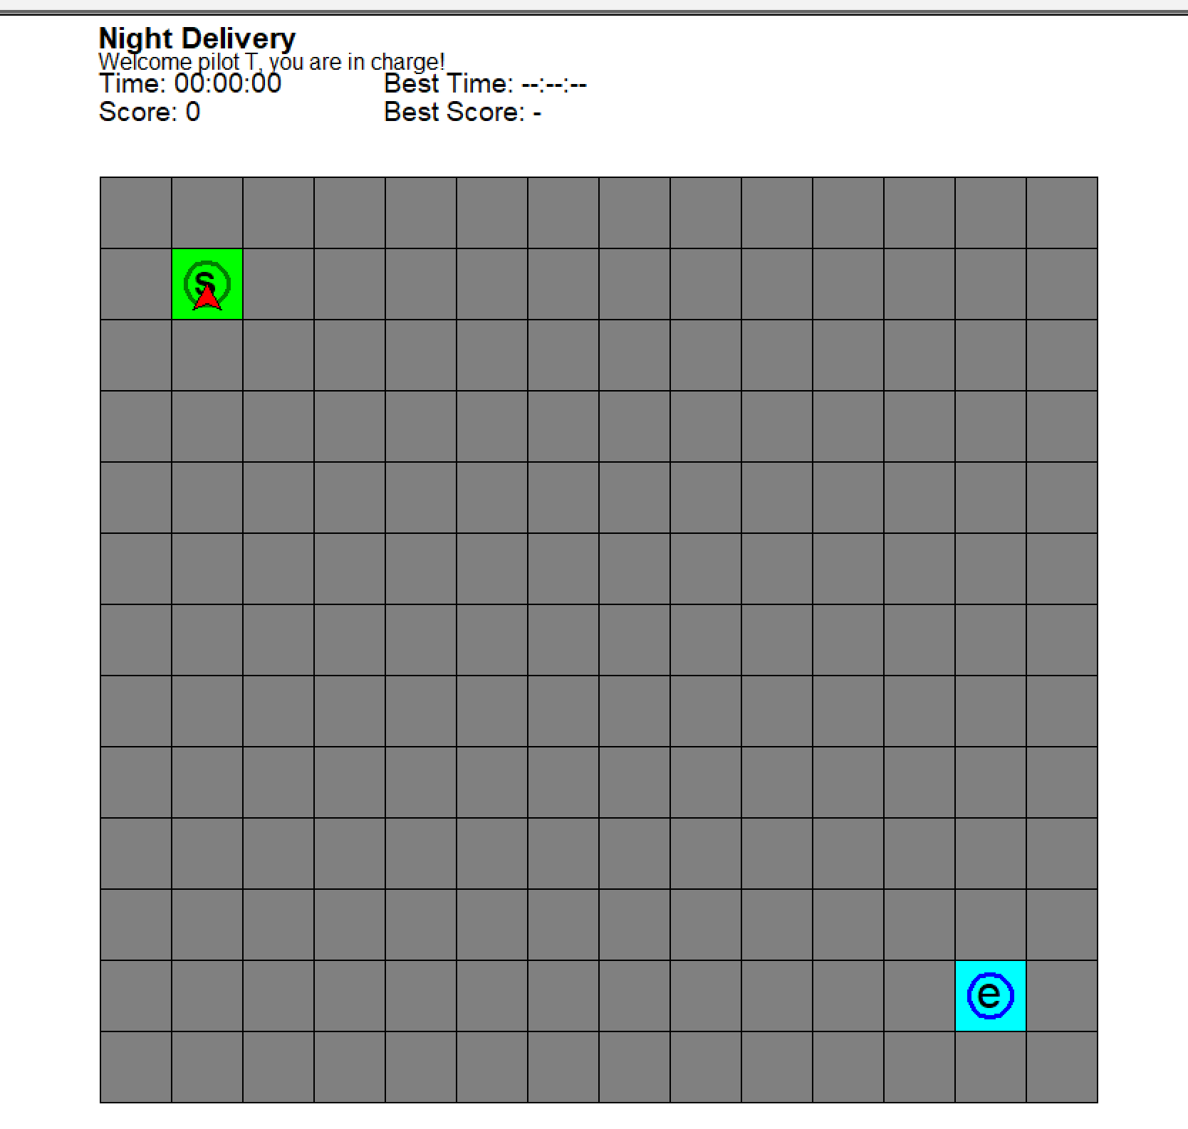
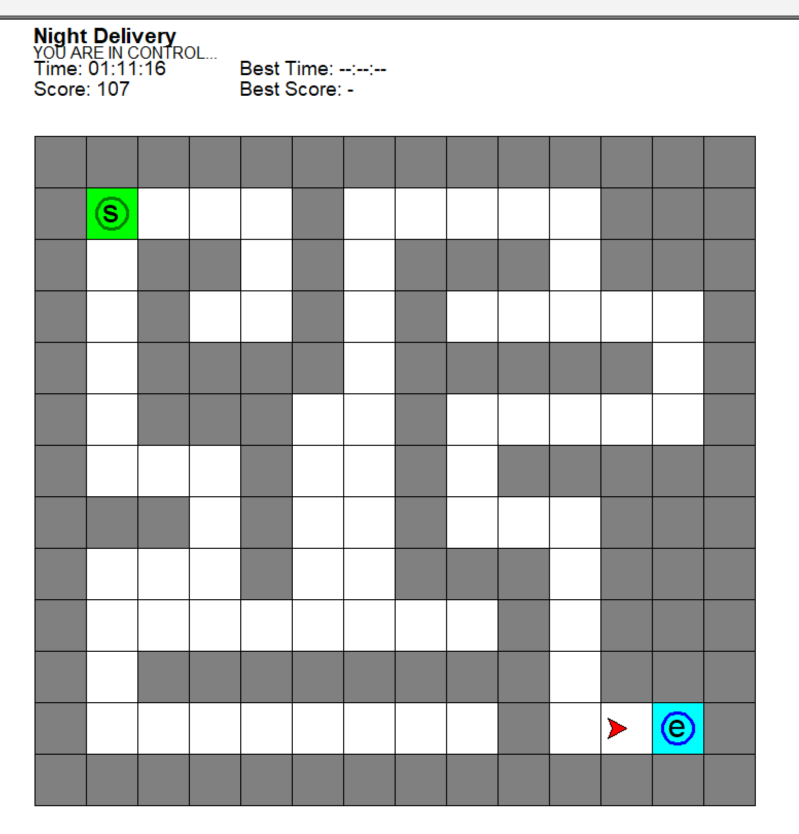
Feature 1 (Night Delivery)
The Drone will be doing a night time delivery, path from the start ‘s’ to end ‘e’ will be hidden
User must navigate using ‘w’, ‘a’, ‘s’ and ‘d’ to find the path
If the Drone is able to move into a tile, color of the tile will change to white, showing the path
If the Drone is not able to move into a tile, Drone’s position will not change

Slide 5
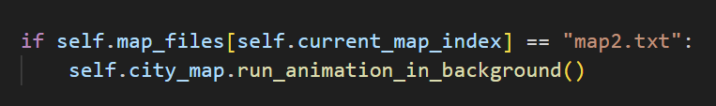
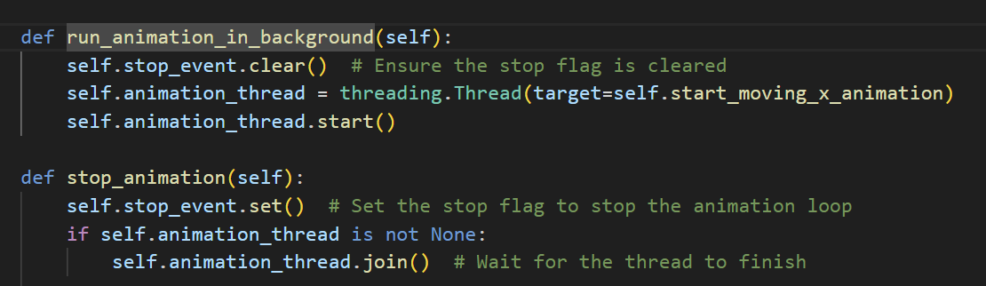
Code added for Feature 2(Obstacle Avoidance)
Display_map function is modified to include a function to run the animation of the bird moving across the screen
In the city_map class these are the run animation and stop animation functions

Slide 6
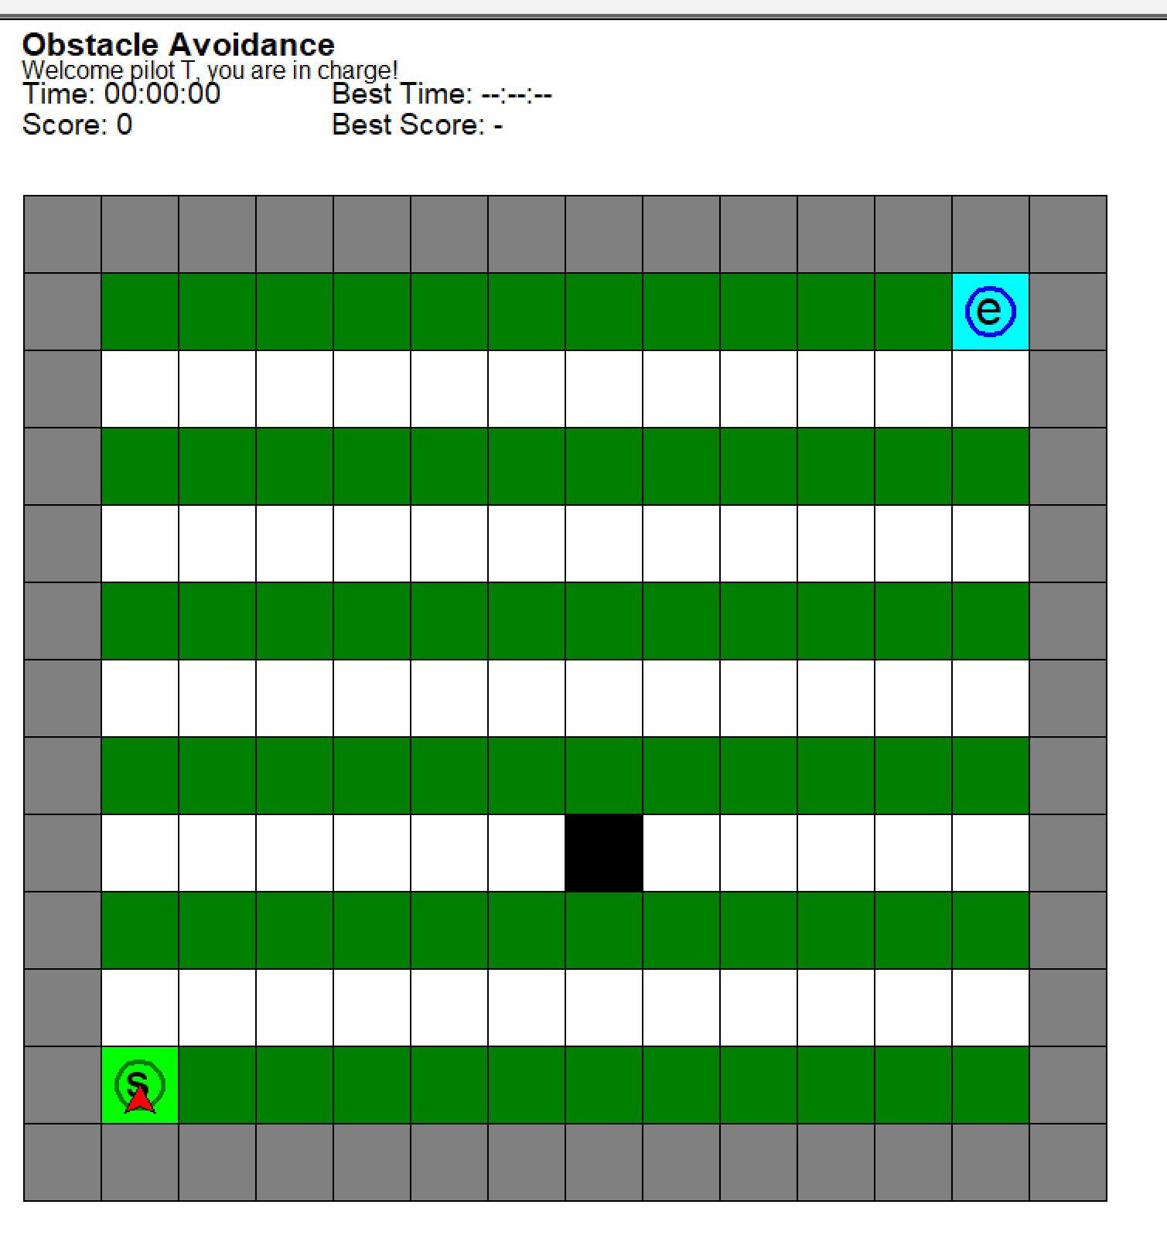
Feature 2 (Obstacle Avoidance)
The Drone will need navigate from start ‘s’ to end ‘e’ where a “Bird” will continuously move across the screen at every alternating row in the map.
User must navigate the map using ‘w’, ‘a’, ‘s’ and ‘d’
Green Tiles are the grass where the “Bird” will not block.
If the Drone hits the “Bird”, its path will be blocked, and the Drone will have to wait for the “Bird” to pass before continuing navigating.

Slide 7
Goals for both Features(Maps)
Drone must navigate from the start ‘s’ to end ‘e’ in the shortest amount of time,
Also, with as few steps as possible for each feature (Map)
Troubleshooting:
If the user wishes to reset, it takes about 1 second for the “Bird” to be removed and start moving again from the bottom right white tile
Closing the application will also take 1 second

Slide 8
Thank you

